Slide 1
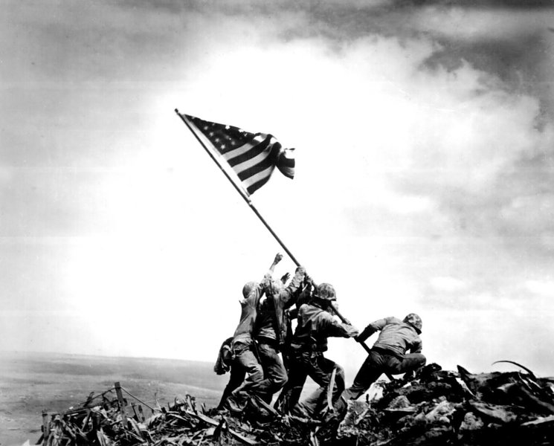
11.11.13 What does this picture show? When was it taken?

Slide 2
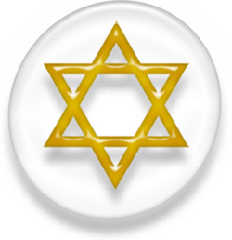
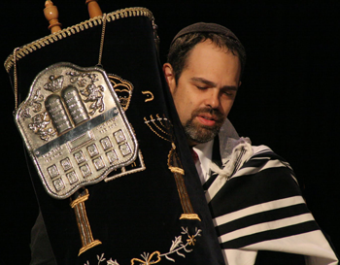
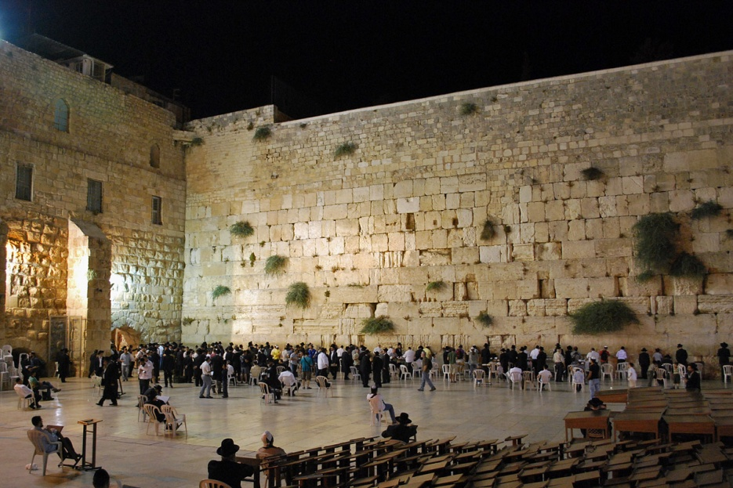
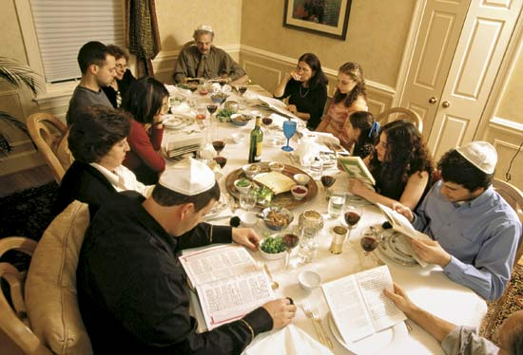
11.12.13 What do these images have in common?

Slide 3
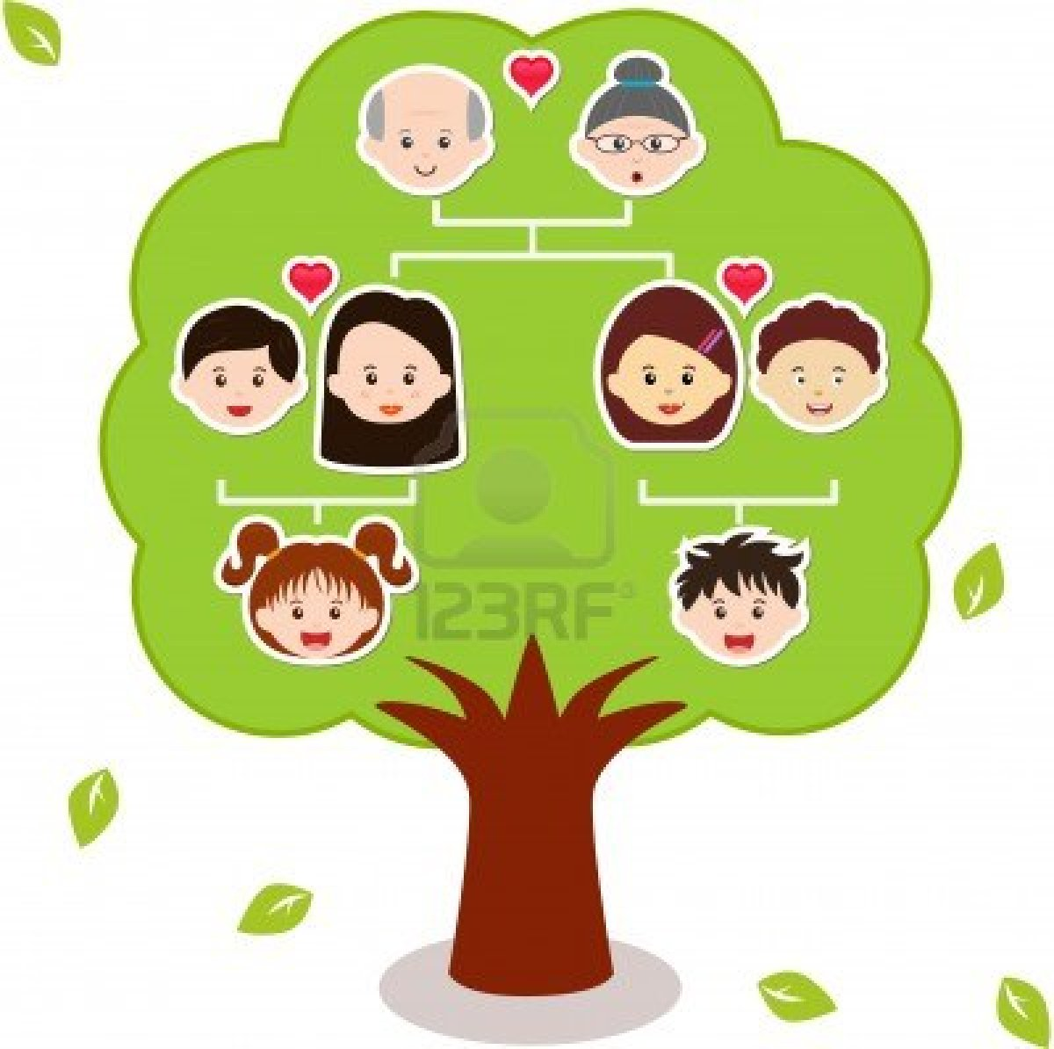
11.13.13
What is a family tree? What is its purpose?

Slide 4
11.14.13
What is the difference between a Matriarch and a Patriarch

Slide 5
Matriarch
- A woman who rules a family, clan, or tribe.
- A woman who dominates a group or an activity.
- A highly respected woman who is a mother.
Patriarch
-A man who rules a family, clan, or tribe.
-One who is regarded as the founder or original head of an enterprise, organization, or tradition.
-A very old, venerable man; an elder.
-The oldest member of a group: the patriarch of the herd

Slide 6
11.15.13
Which law(s) governs all other laws of the United States?
Which law(s) governed all other Hebrew laws?

Slide 7
-The Constitution of the United States.

