Slide 2
10.21.13
How does religion impact the United States
-Government
-Culture
-Economy
-Perspective
-Geography?

Slide 3
10.23.13
Why should you always wear your seatbelt?

Slide 4
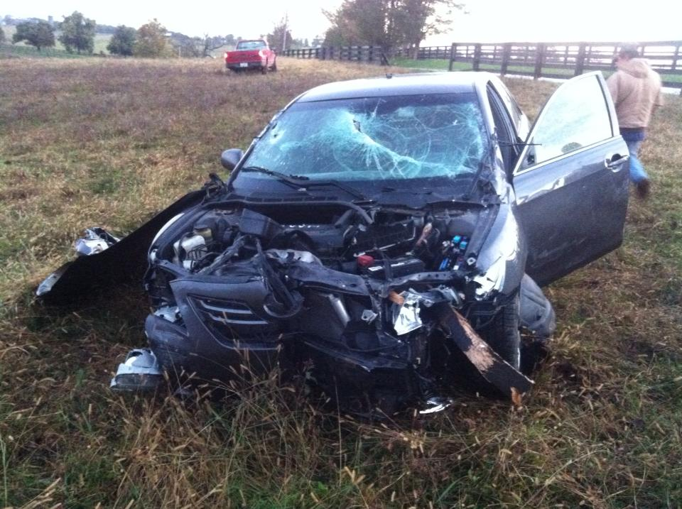

Slide 5
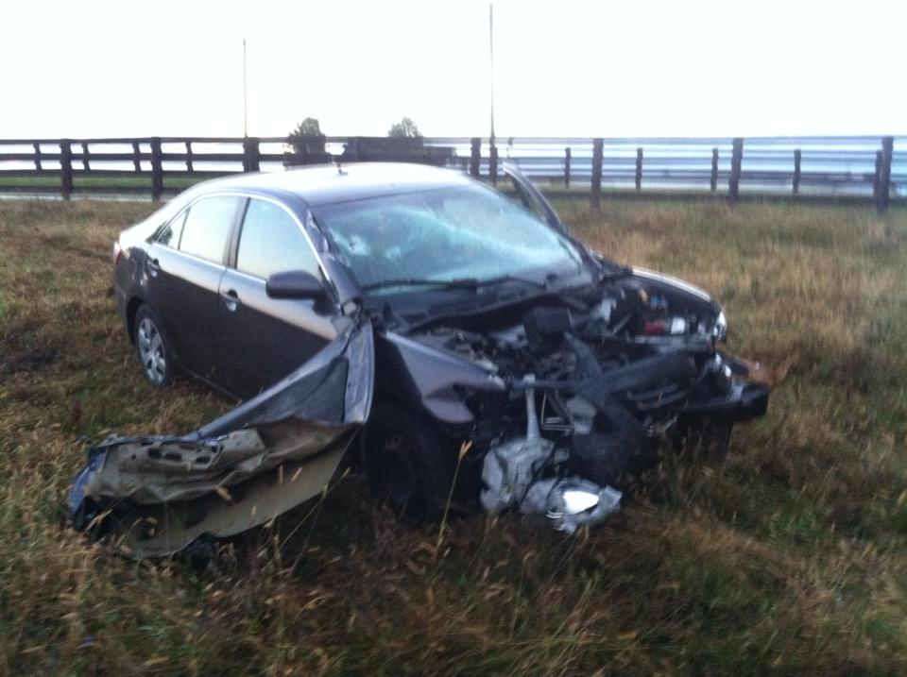

Slide 6
Bellringer 10.24.13
What leadership qualities should a pharaoh have?

Slide 7
10.25.13
What places would you like to go?

Slide 8
What you need to do today.
Finish answering all questions
Create a Five slide powerpoint to answer the questions on your pharaoh.
You need to also include a title slide with the name of the pharaoh and the last slide will include all of the names of the group members.

