Slide 1
Bellringer 9.30.13
What direction did the Nile flow?
What did the river offer the ancient Egyptians?

Slide 2
10.1.13
Why do you list the sources you used for research?

Slide 3
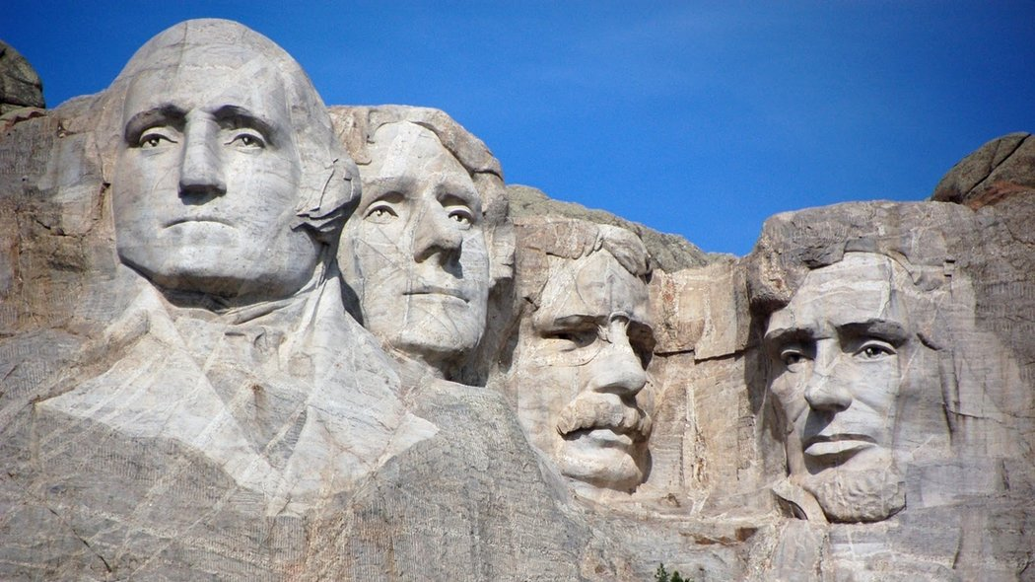
Bellringer 10.2.13 In whose honor do you think this monument was built? Why do you think this monument was built in honor of these four men?

Slide 4
10/2/13 Exit Slip
On the back of your Venn diagram please answer the following questions…
Describe one similarity and one difference a pharaoh and president have in their roles and responsibilities.
What leadership characteristics must a president have to be successful? What leadership characteristics must a pharaoh have to be successful?
3) How are these characteristics (for the pharaoh/ president) similar? How are they different?

Slide 5
10.3.13
What does Pharaoh mean?
List three roles and responsibility of pharaoh from yesterdays' lesson.

Slide 6
10.4.13
Define Papyrus, then hand in your bellringers when you are finished.
*Prepare for your quiz by removing everything except 1 pencil/pen and 1 piece of paper.
*Put your name on your paper and number 1-17 for the quiz.

