Slide 1
Bellringer 4 4.28.14
Describe what happened to Jesus of Nazareth.
(Write more than he died. Explain why and how….)

Slide 2
4.29.14
The holy book of Islam is called
The Koran
The Bible
The Torah
a scroll
The prophet of the Islamic religion is
Jesus
Moses
Muhammad
Gandhi

Slide 3
4.30.14 Write True or false for each statement
Islam, Christianity, and Judaism share some of the same stories in their religious texts.
A rock can be holy site.
Islam, Christianity, and Judaism all share one God.
The lands talked about in Judaism, Islam, and Christianity are close to each other geographically.
Christianity and Islam are the religions with the most
followers in the world

Slide 4
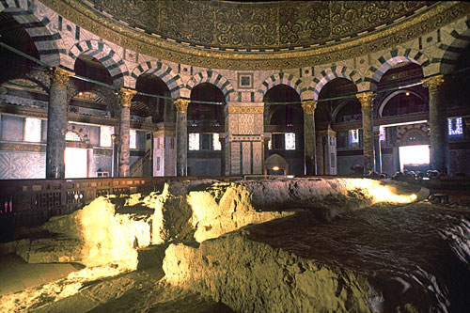
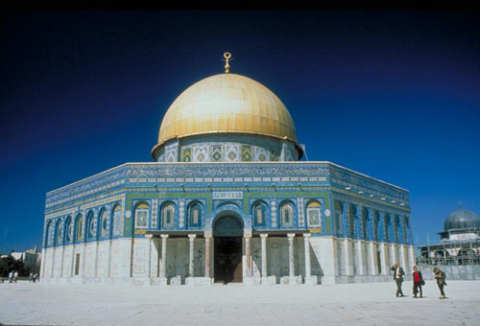

Slide 5
The Temple Mount is one of the most important religious sites in the Old City of Jerusalem. It has been used as a religious site for thousands of years. At least four religions are known to have used the Temple Mount: Judaism, Christianity, Roman religion, and Islam.

Slide 6
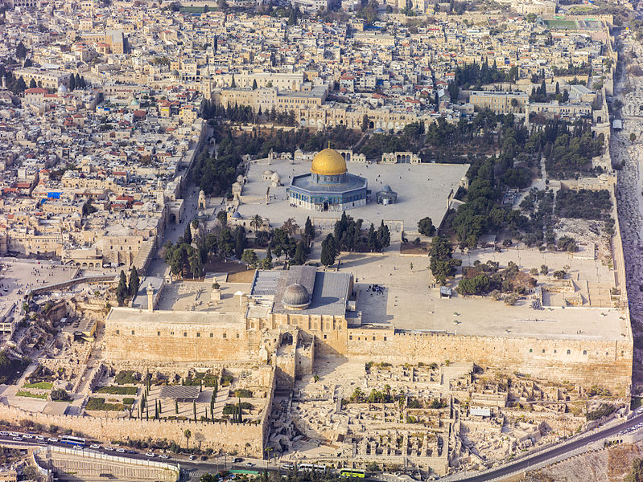

Slide 7
Prompt: Christianity, Islam, and Judaism have similar historical backgrounds. These three religions have greatly impacted world history through many generations.
A. Contrast Judaism, Christianity, and Islam, Describe at least three ways these religions are different.
B. Compare the religions of Judaism, Christianity, and Islam, Describe at least three ways these religions are similar.
C. Explain how geography has impacted the growth of religion over time.
D. Describe how religions can lead to conflict and conflict resolution. Give at least three examples for each.

Slide 8
Prompt: Christianity, Islam, and Judaism have similar historical backgrounds. These three religions have greatly impacted world history through many generations.
A. Contrast Judaism, Christianity, and Islam, Describe at least three ways these religions are different.
B. Compare the religions of Judaism, Christianity, and Islam, Describe at least three ways these religions are similar.
C.. Describe how religions can lead to conflict and conflict resolution. Give at least three examples for each.

Slide 9
5.1.14
What do you know about the Medieval time period? Write three things you already know about this time.

Slide 10
5.2.14
What is your current grade in this class?
Are you missing any assignments, if so what is your plan to make-up those assignments before testing begins.

