Slide 2
3.6.14
Name another individual who addressed race issues during their lifetime like Fredrick Douglas. What did they do? How are they alike? How are they different?

Slide 3
3.7.14
What power do the citizens have in a Republic?
Why would the citizens want this power?

Slide 4
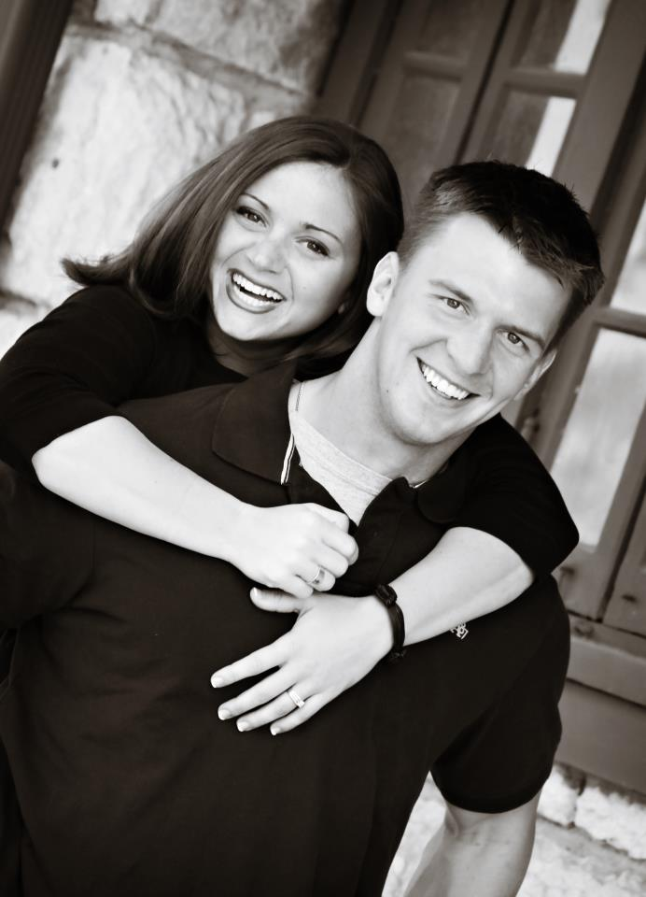
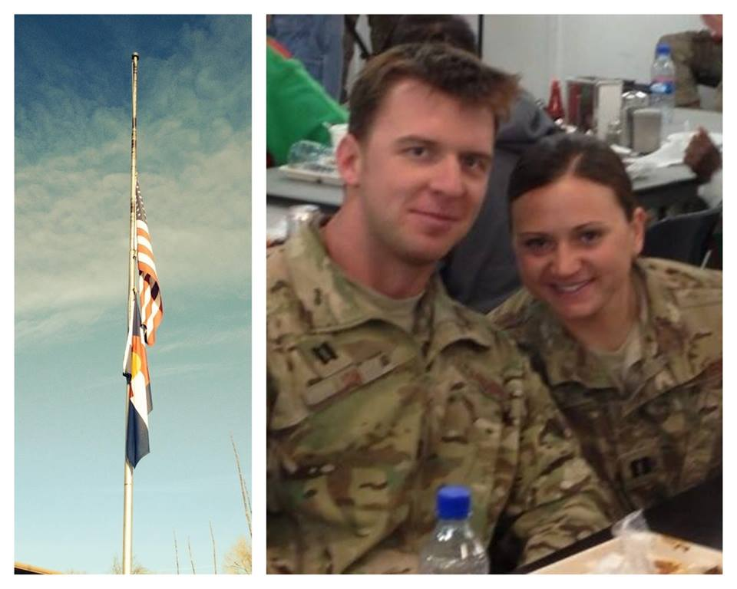

Slide 5
