Slide 2
11.4.13
Which architectural structures are most associated with ancient Egypt? Why?

Slide 3
11.5.13
How has Egypt influenced American architecture?

Slide 4
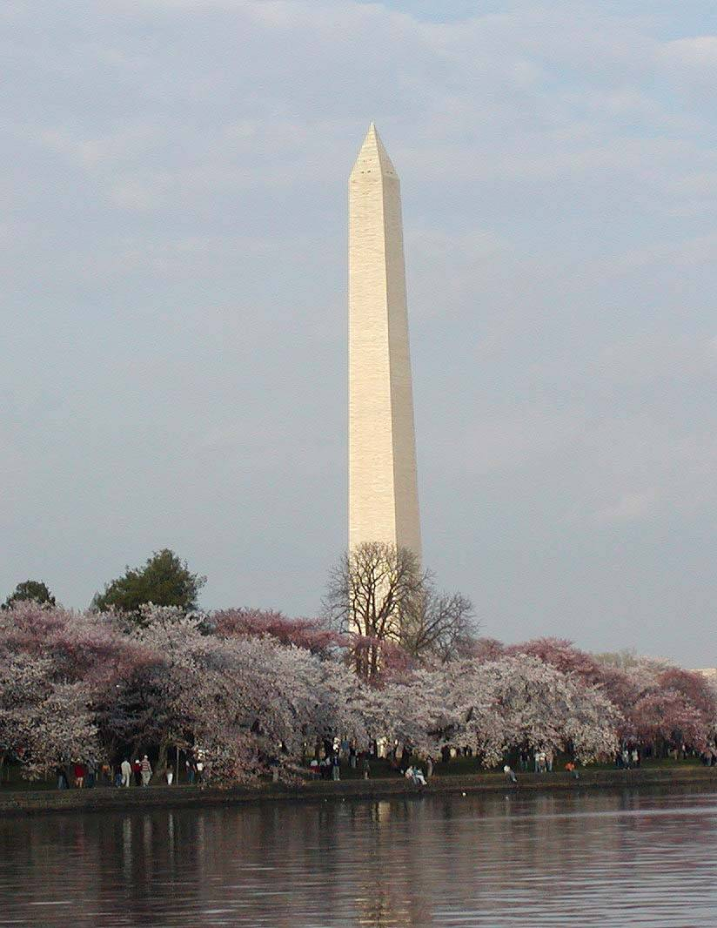
Memorials

Slide 5
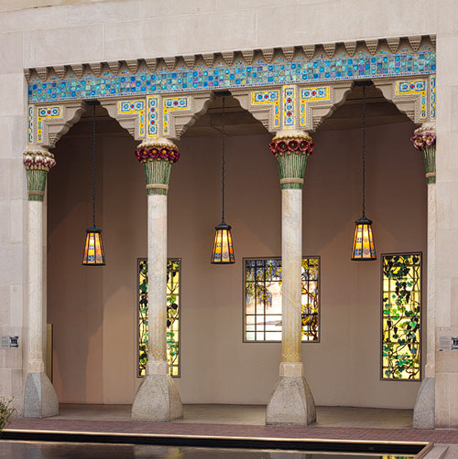
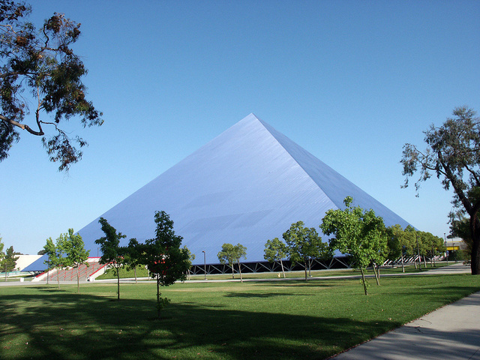
Homes and Schools

Slide 6
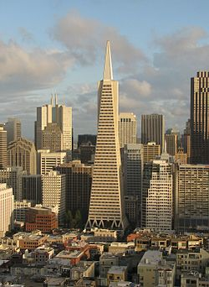
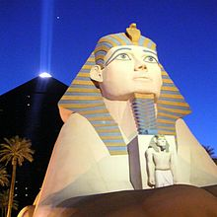
Hotels/Businesses

Slide 7
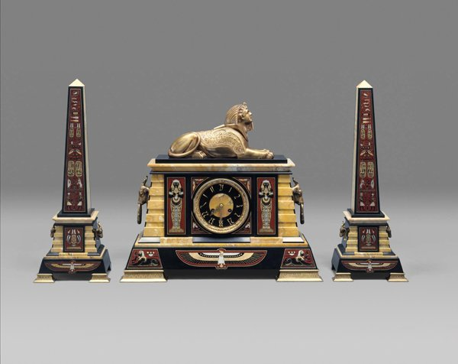
Furniture

Slide 8
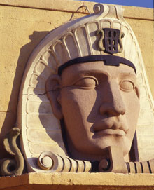
Movie Theaters

Slide 9
Theaters

Slide 10
11.6.13 What devise would you need in order to understand this bar code? Why can’t you read it without the devise?

Slide 11
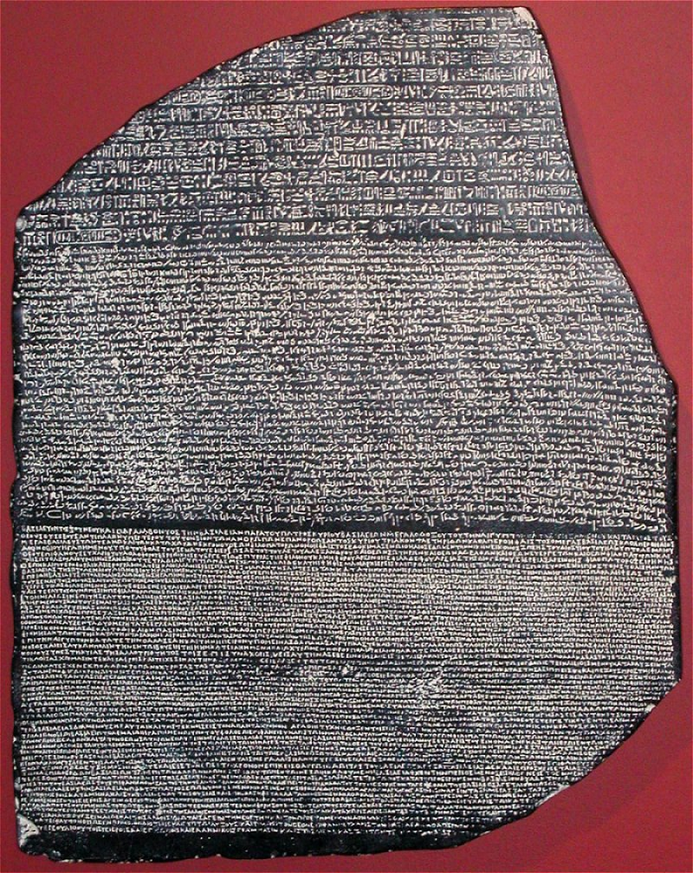
Rosetta Stone
What is the Rosetta Stone?
The Rosetta Stone is a stone with writing on it in two languages (Egyptian and Greek), using three scripts (hieroglyphic, demotic and Greek). It was carved in 196 BCE.
Why is it in three different scripts?
The Rosetta Stone is written in three scripts (hieroglyphs for religious documents; demotic- common script of Egypt; Greek- language of the rulers of Egypt at that time)
The Rosetta Stone was written in all three scripts so that the priests, government officials and rulers of Egypt could read what it said.
When was the Rosetta Stone found?
The Rosetta Stone was found in 1799 by French soldiers who were rebuilding a fort in Egypt (in a small village in Delta called Rosetta (Rashid)
What does the Rosetta Stone say?
The Rosetta Stone is a text written by a group of priests in Egypt to honour the Egyptian pharaoh. It lists all of the things that the pharaoh had done that were good for the priests and the people of Egypt.

Slide 12
11.7.13
Should the Rosetta Stone be returned to Egypt? Why or why not?

Slide 13
11.8.13
Ancient Egyptian history is divided into three periods. What are the names of the three periods?

